Slide 1

Design and Analysis of Real Time Multi-Robot Task Allocation System
Yangon Technological University
Department of Electronic Engineering
PROGRESS SEMINAR
Presented by:
Min Thant Kyaw (VI EC-1)
Supervisor : Dr. Khin Kyu Kyu Win
Members : Daw Thi Thi Soe
Daw Zin Nwe Nyo Htun
Chairman : Dr. Lei Lei Yin Win
Date: 23.7.2026 (Thursday)

Slide 2
Outline of Presentation
01.
Introduction
05.
Research Timeline
02.
Previous Work
06.
Future Work
03.
Current Progress
07.
Conclusion
04.
Tests & Results
08.
References

Slide 3
1. Introduction
Website User Interface
Create Tasks
Min Thant Kyaw’s Responsibility
Hein Htet Zaw’s Responsibility
Aung Kaung Set’s Responsibility
Task Allocation & Scheduling
MILP Dataset Generation
XGBoost Classifier Training
Optimized Task Assignment
Si Thu Lin Htet’s Responsibility
Path Planning & Navigation
A* Path Planning
Determine Optimal Route
Dynamic Replanning
Vision System
Central Server
Task Management
Map & Checkpoints
Robot Status Monitor
Communication Hub
ESP32-CAM
QR Recognition
Robot/ Object Detection
AGV Control & Localization
Line Following
(PID Control)
RFID Localization
Encoder Feedback
AGV Robot 1
AGV Robot 2
Figure 1.1: Overall Block Diagram for Warehouse Management System

Slide 4
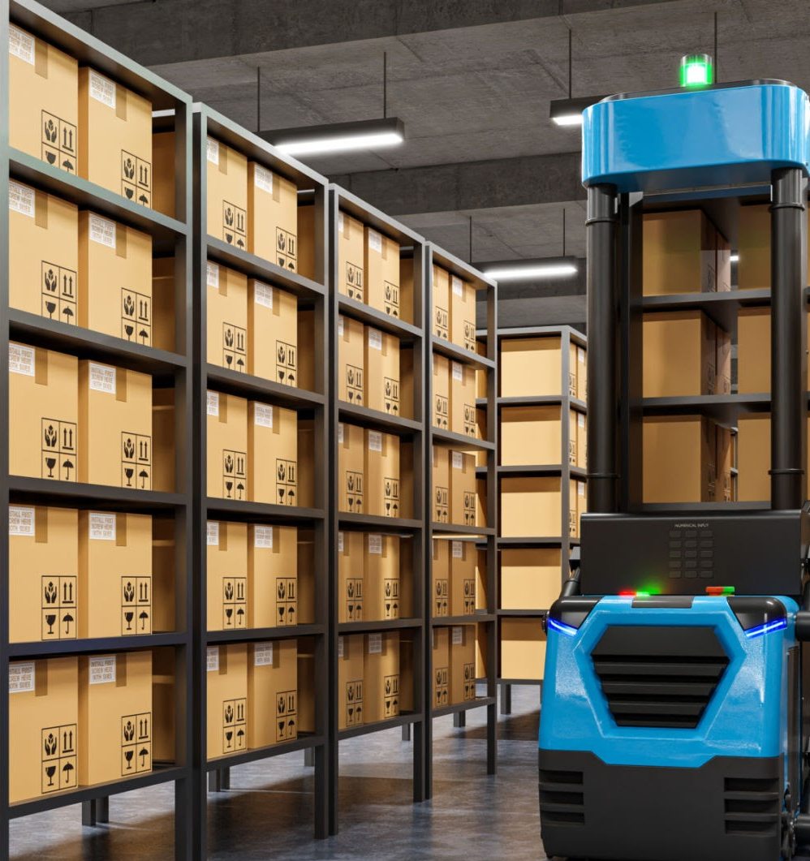
1. Introduction
Modern warehouses rely on multiple autonomous robots.
Tasks must be assigned efficiently to each robot.
Centralized MILP finds globally optimal solutions.
However, it becomes computationally expensive in real time.
Figure 1.2: Autonomous Warehouse Robot

Slide 5
1. Introduction
1.1. Aim & Objectives
To develop a learning-based multi-robot task allocation system to optimize the warehouse environment.
To design a warehouse's layout and create a MILP-generated dataset.
To develop an XGBoost model for task allocation prediction.
To develop a local server for task management and processing.
To implement real-time communication between the server and robots.

Slide 6
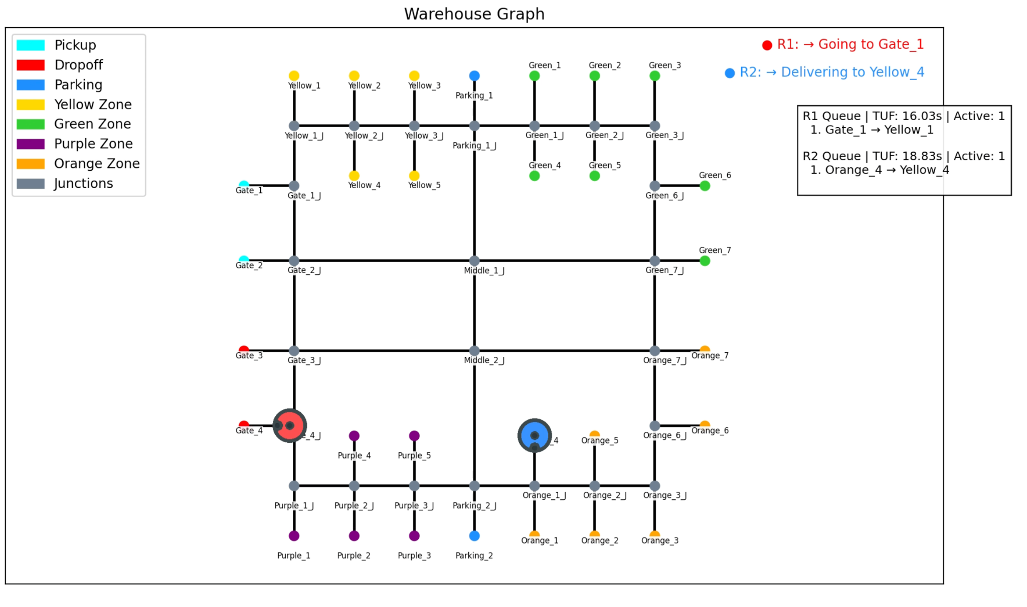
2. Previous Work
2.1. Warehouse Layout Design
Figure 2.1: Warehouse Graph with NetworkX

Slide 7
2. Previous Work
2.2. MILP Dataset Generation
Warehouse Simulation
Total dataset size: 20,019
Number of features: 18
Batch size range: 1-7
Target: Assigned Robot
Output Classes: Robot_1, Robot_2
Task Generation
MILP Optimization
Optimal Robot Assignment
Save Training Dataset
MILP = Mixed-Integer Linear Programming
Figure 2.2: MILP Dataset Generation Process

Slide 8
3. Current Progress
3.1. XGBoost Classifier Training
MILP Dataset
Comparative Analysis
XGBoost Classifier
System Evaluation
Robot Assignment
Model Performance Evaluation
Figure 3.1: Workflow of XGBoost Classifier

Slide 9
3. Current Progress
3.1.1 Features Comparison
No. | Feature Category | This Research | Reference Papers
1 | Pickup and Dropoff Locations | ✓ | ✓
2 | Physical Distance Between Nodes | ✓ | ✓
3 | Robot Coordinates | ✓ | ✓
4 | Robot Charging Percentage | ✗ | ✓
5 | Congestion Tracking | ✗ | ✓
6 | Temporal Constraints | ✓ | ✓
7 | Future Available Time | ✓ | ✓
8 | Relative Features | ✓ | ✗
Table 3.1: Comparison of Features

Slide 10
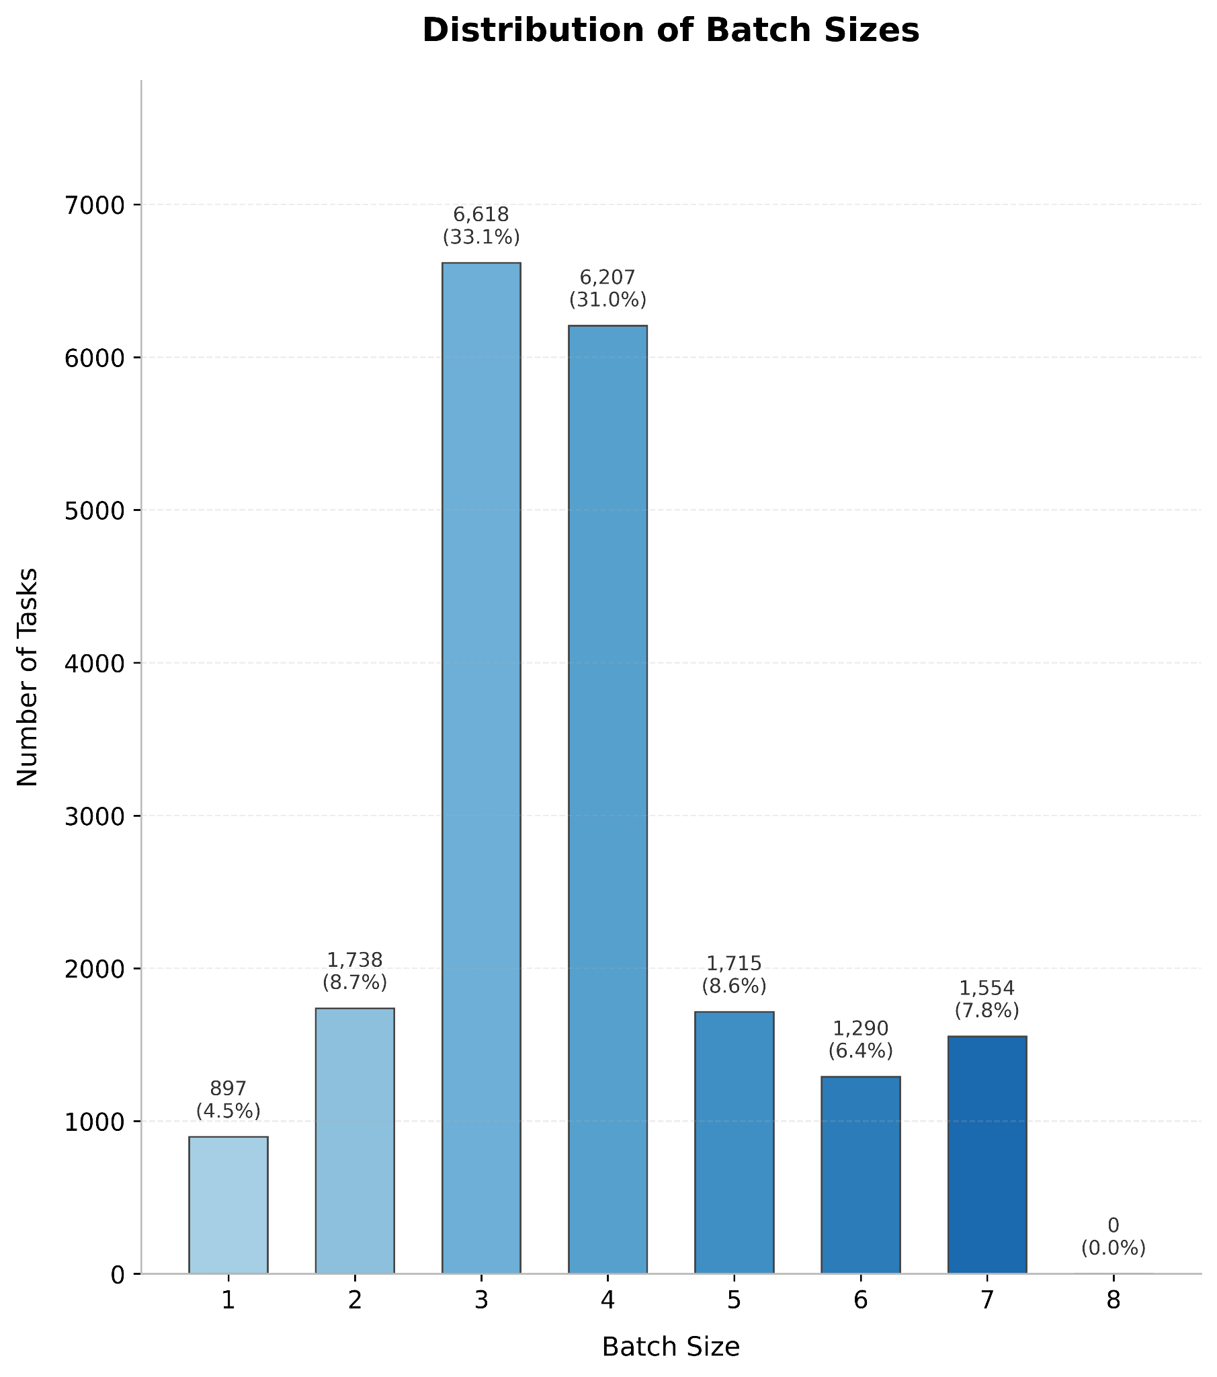
3. Current Progress
3.1.2 Classifier Configuration
Batch Size:
1-7
Train/ Test Split:
75% / 25%
Objective:
Binary: Logistic
Evaluation Metric:
AUC-PR
Hyperparameter
Optimization:
Hyperopt
(100 Trials)
AUC-PR = Area Under Curve - Precision Recall
Figure 3.2: Batch Sizes Distribution

Slide 11
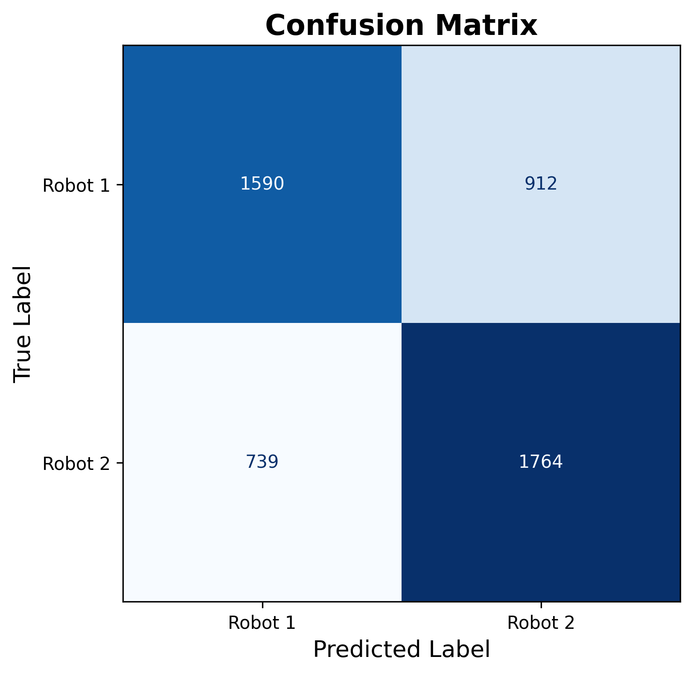
3. Current Progress
3.1.3 Classifier Performance (B1-7)
Precision
Recall
0.6592
0.7048
F1 Score
Accuracy
0.6812
0.6701
Figure 3.3: Confusion Matrix for XGBoost Classifier

Slide 12
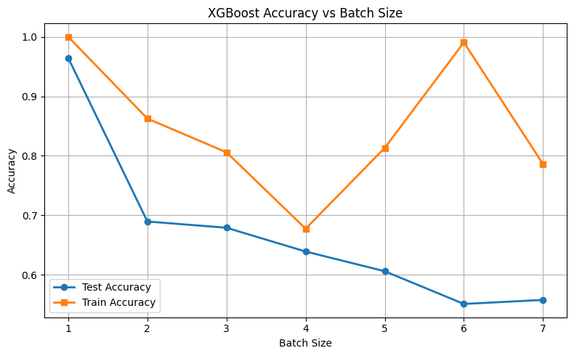
3. Current Progress
3.1.4 Batch Size Investigation
Figure 3.4:Investigation of XGBoost classification accuracy under different batch sizes.

Slide 13
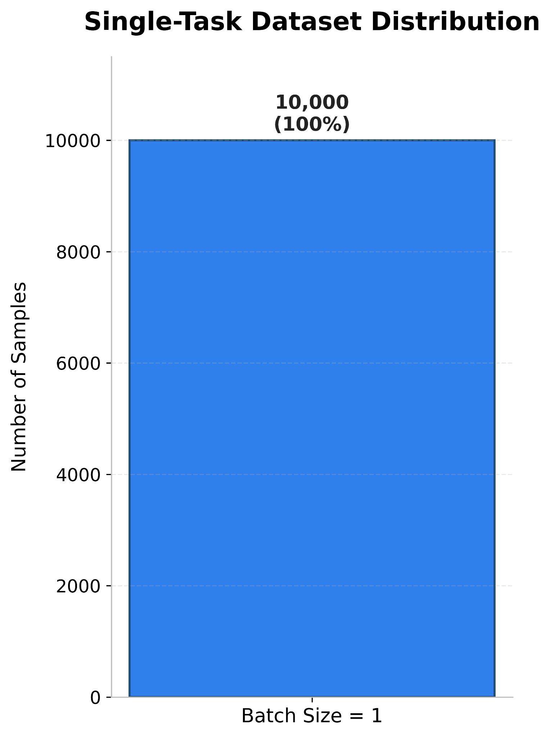
3. Current Progress
3.2 Single-Task Dataset
Batch Size:
1
Train/ Test Split:
75% / 25%
Objective:
Binary: Logistic
Evaluation Metric:
AUC-PR
Hyperparameter
Optimization:
Hyperopt
(100 Trials)
AUC-PR = Area Under Curve - Precision Recall
Figure 3.5: Single-Task Dataset Distribution

Slide 14
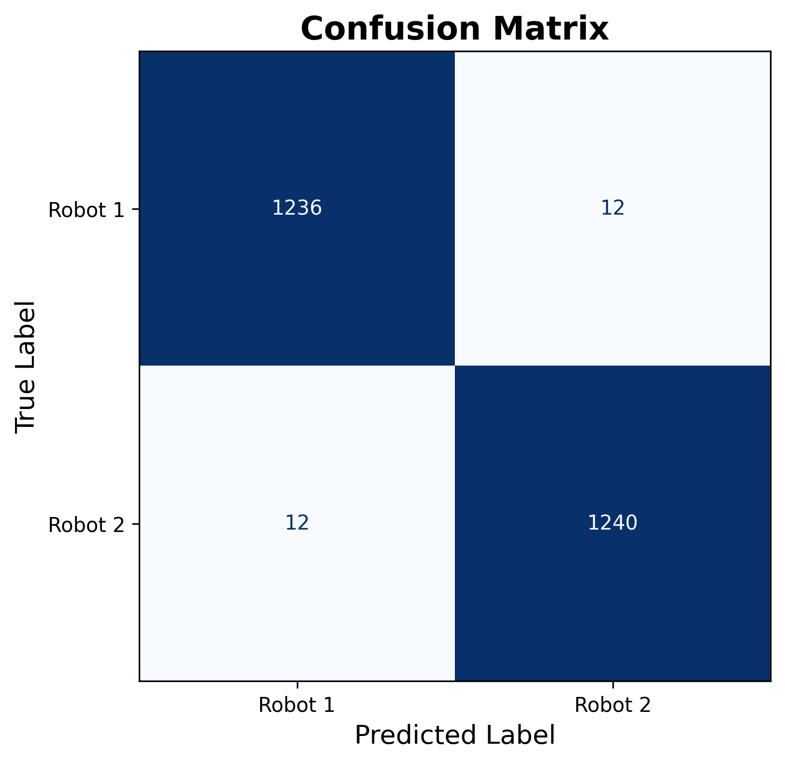
3. Current Progress
3.2.1 Classifier Performance (B1)
Precision
Recall
0.9904
0.9904
F1 Score
Accuracy
0.9904
0.9904
Figure 3.6: Confusion Matrix for XGBoost Classifier

Slide 15
3. Current Progress
3.3 Comparison of Models
Dataset | Precision | Recall | F1 Score | Accuracy
Mixed Batch Dataset (Batch Size: 1-7) | 0.6592 | 0.7048 | 0.6812 | 0.6701
Mixed Batch Dataset (Batch Size: 1-7) With Hyperopt Optimization | 0.6609 | 0.7048 | 0.6821 | 0.6715
Single Task Dataset (Batch Size: 1) | 0.9904 | 0.9904 | 0.9904 | 0.9904
Single Task Dataset (Batch Size: 1) With Hyperopt Optimization | 0.9936 | 0.9896 | 0.9916 | 0.9916
Table 3.2: Comparison of XGBoost models with different datasets and optimization

Slide 16
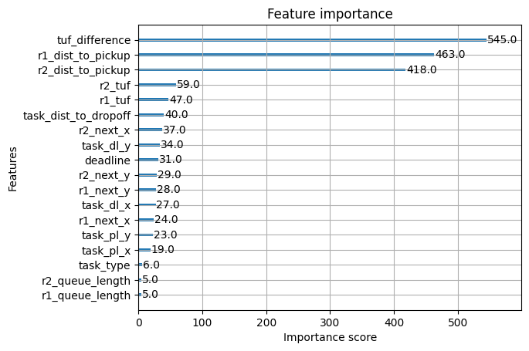
3. Current Progress
3.4 Feature Importance
Figure 3.7: Feature Importance for XGBoost Classifier

Slide 17
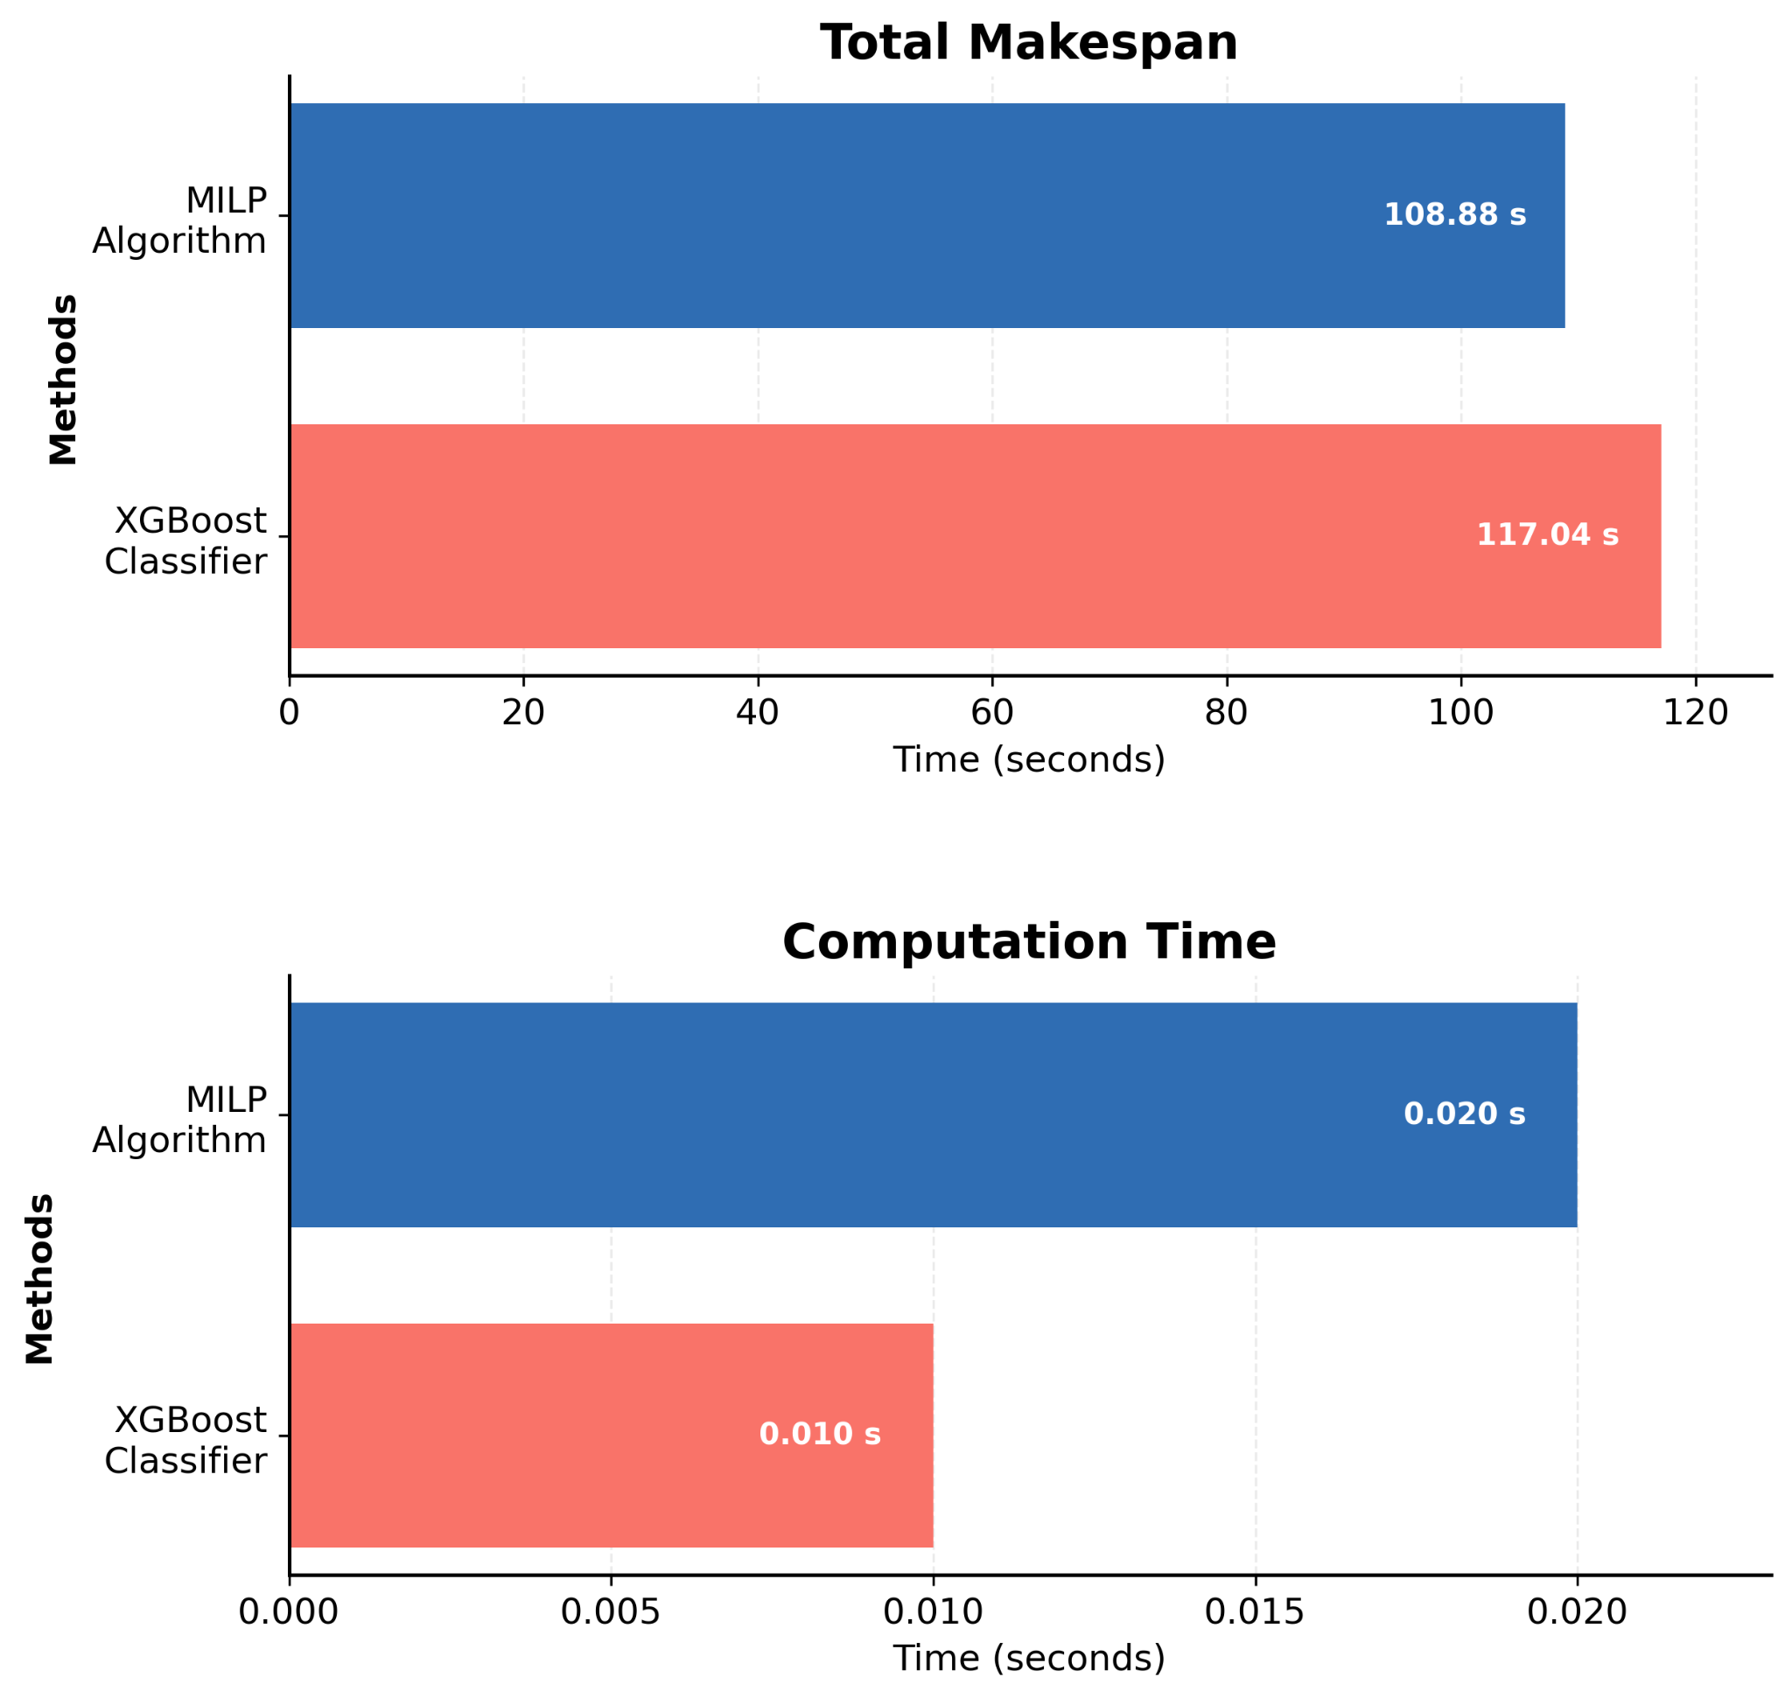
3. Current Progress
3.5 System Evaluation
Test Scenario
Fixed 10 Tasks
Same Pattern of Task Arrival
Makespan Gap:
6.94%
Computation Time Reduction:
50%
Figure 3.8: Comparison plots for fixed 10 tasks

Slide 18
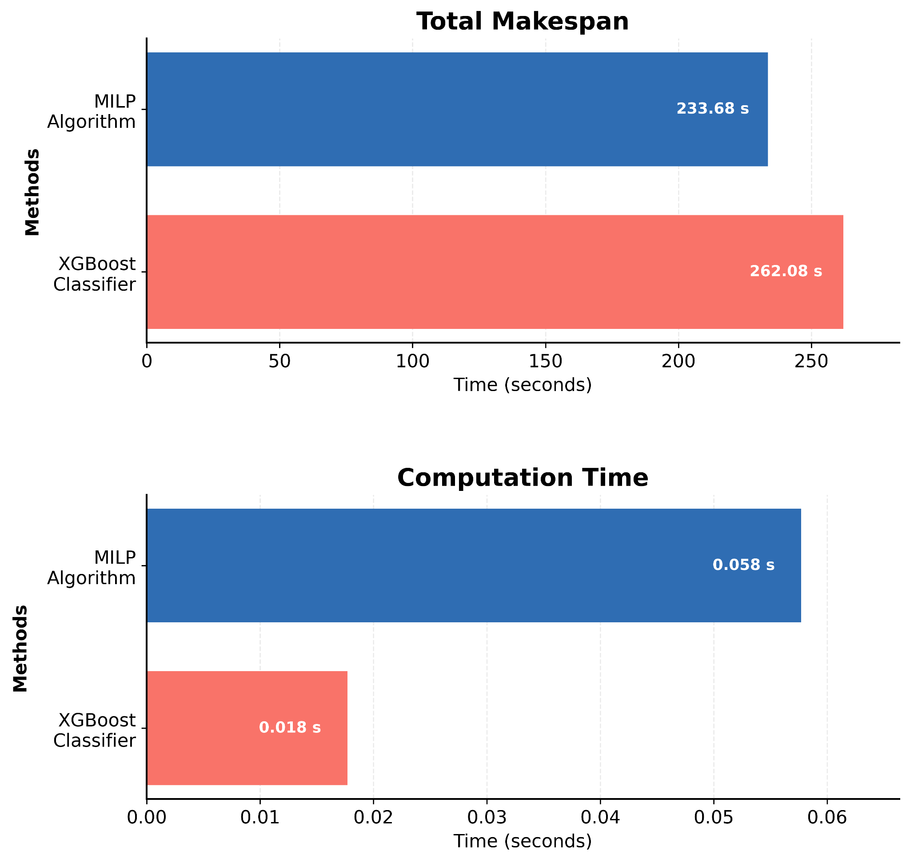
3. Current Progress
3.5 System Evaluation (Cont’d)
Test Scenario
Fixed 20 Tasks
Same Pattern of Task Arrival
Makespan Gap:
10.83%
Computation Time Reduction:
68.96%
Figure 3.9: Comparison plots for fixed 20 tasks

Slide 19
3. Current Progress
3.6 Modified Architecture
Makespan gap remains between XGBoost Classifier and MILP.
MILP reduces makespan through task reordering.
Developing XGBoost Learning-to-Rank for task re-ranking.
New Task Arrival
First Come
First Serve
Assignment
XGBoost Classifier
Append to Robot Queue
XGBoost Learning to Rank (LTR) Algorithm
Task Assignment
with Dynamic
Task Re-ranking
Reorder Pending Tasks

Slide 20
3. Current Progress
3.6.1 XGBoost LTR Dataset Features
Task Distance Relationship
Deadline & Task Urgency
Remaining deadline
Deadline comparison
Estimated lateness
Measures how close a task is to other tasks to estimate travel efficiency.
Distance to Nearest Pickup
Average Distance to Other Pickups
Nearest Next Task Distance
Average Next Task Distance
Completion Prediction
Estimated completion time
Finish time if executed next
Finish time if executed last

Slide 21
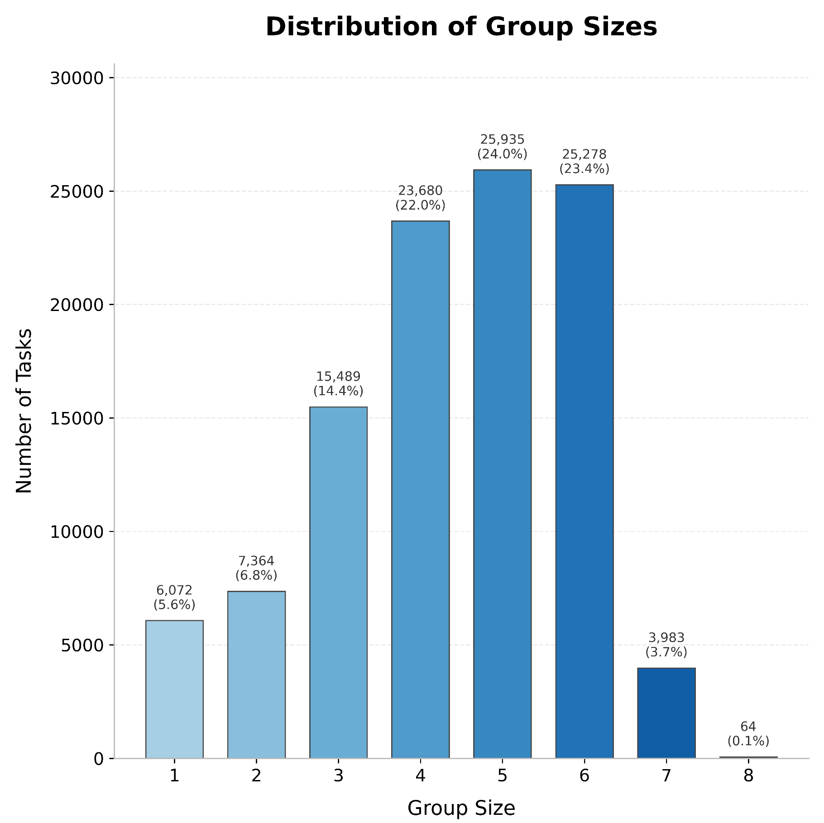
3. Current Progress
3.6.2 XGBoost LTR Dataset Analysis
Number of Samples:
10,7865
Number of Features:
80% / 20%
Objective:
NDCG@1
Evaluation Metric:
NDCG
NDCG = Normalized Discounted
Cumulative Gain
NDCG@1 = Normalized Discounted
Cumulative Gain at Top-1 Task
Figure 3.10:Group Sizes Distribution

Slide 22
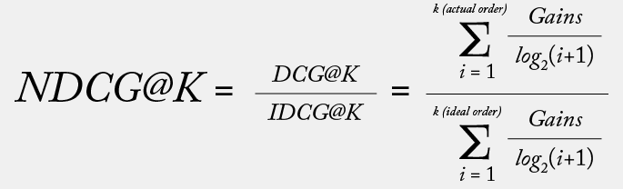
3. Current Progress
3.6.3 XGBoost LTR Evaluation Metrics
NDCG
DCG
IDCG
Gains
K
i
=
=
=
=
=
=
Normalized Discounted Cumulative Gain
Discounted Cumulative Gain
Ideal Discounted Cumulative Gain
The relevance (gain) score of the task
Number of top-ranked items
The position (rank index) of a task in the ranked list

Slide 23
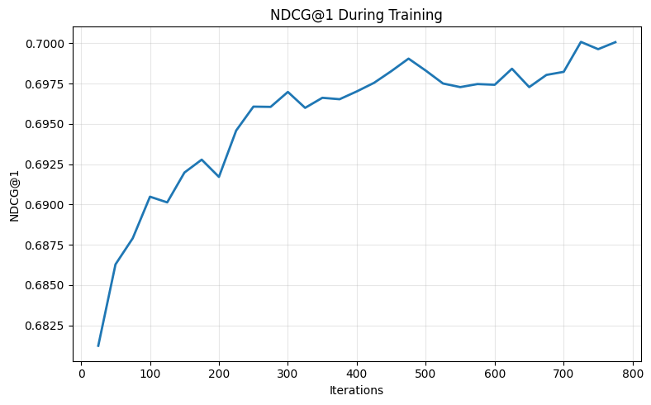
3. Current Progress
3.6.4 XGBoost LTR Model Performance
NDCG:
0.8835
NDCG@1
0.7002
Figure 3.11: Plot for NDCG@1 During Training

Slide 24
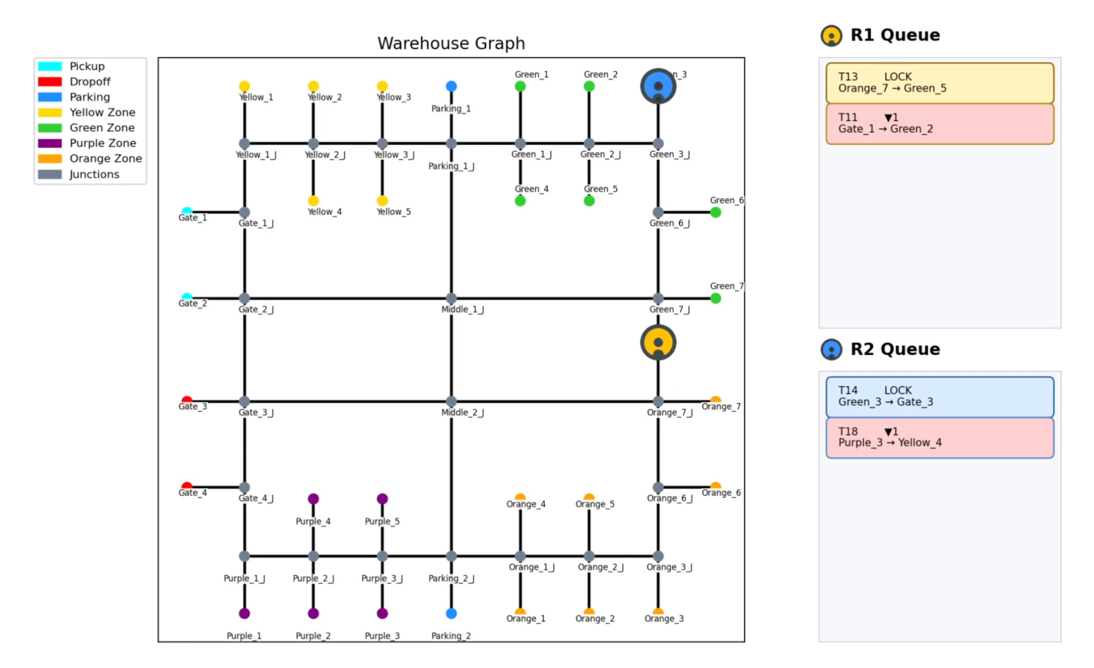
4. Tests and Results
4.1 Simulation Video

Slide 25
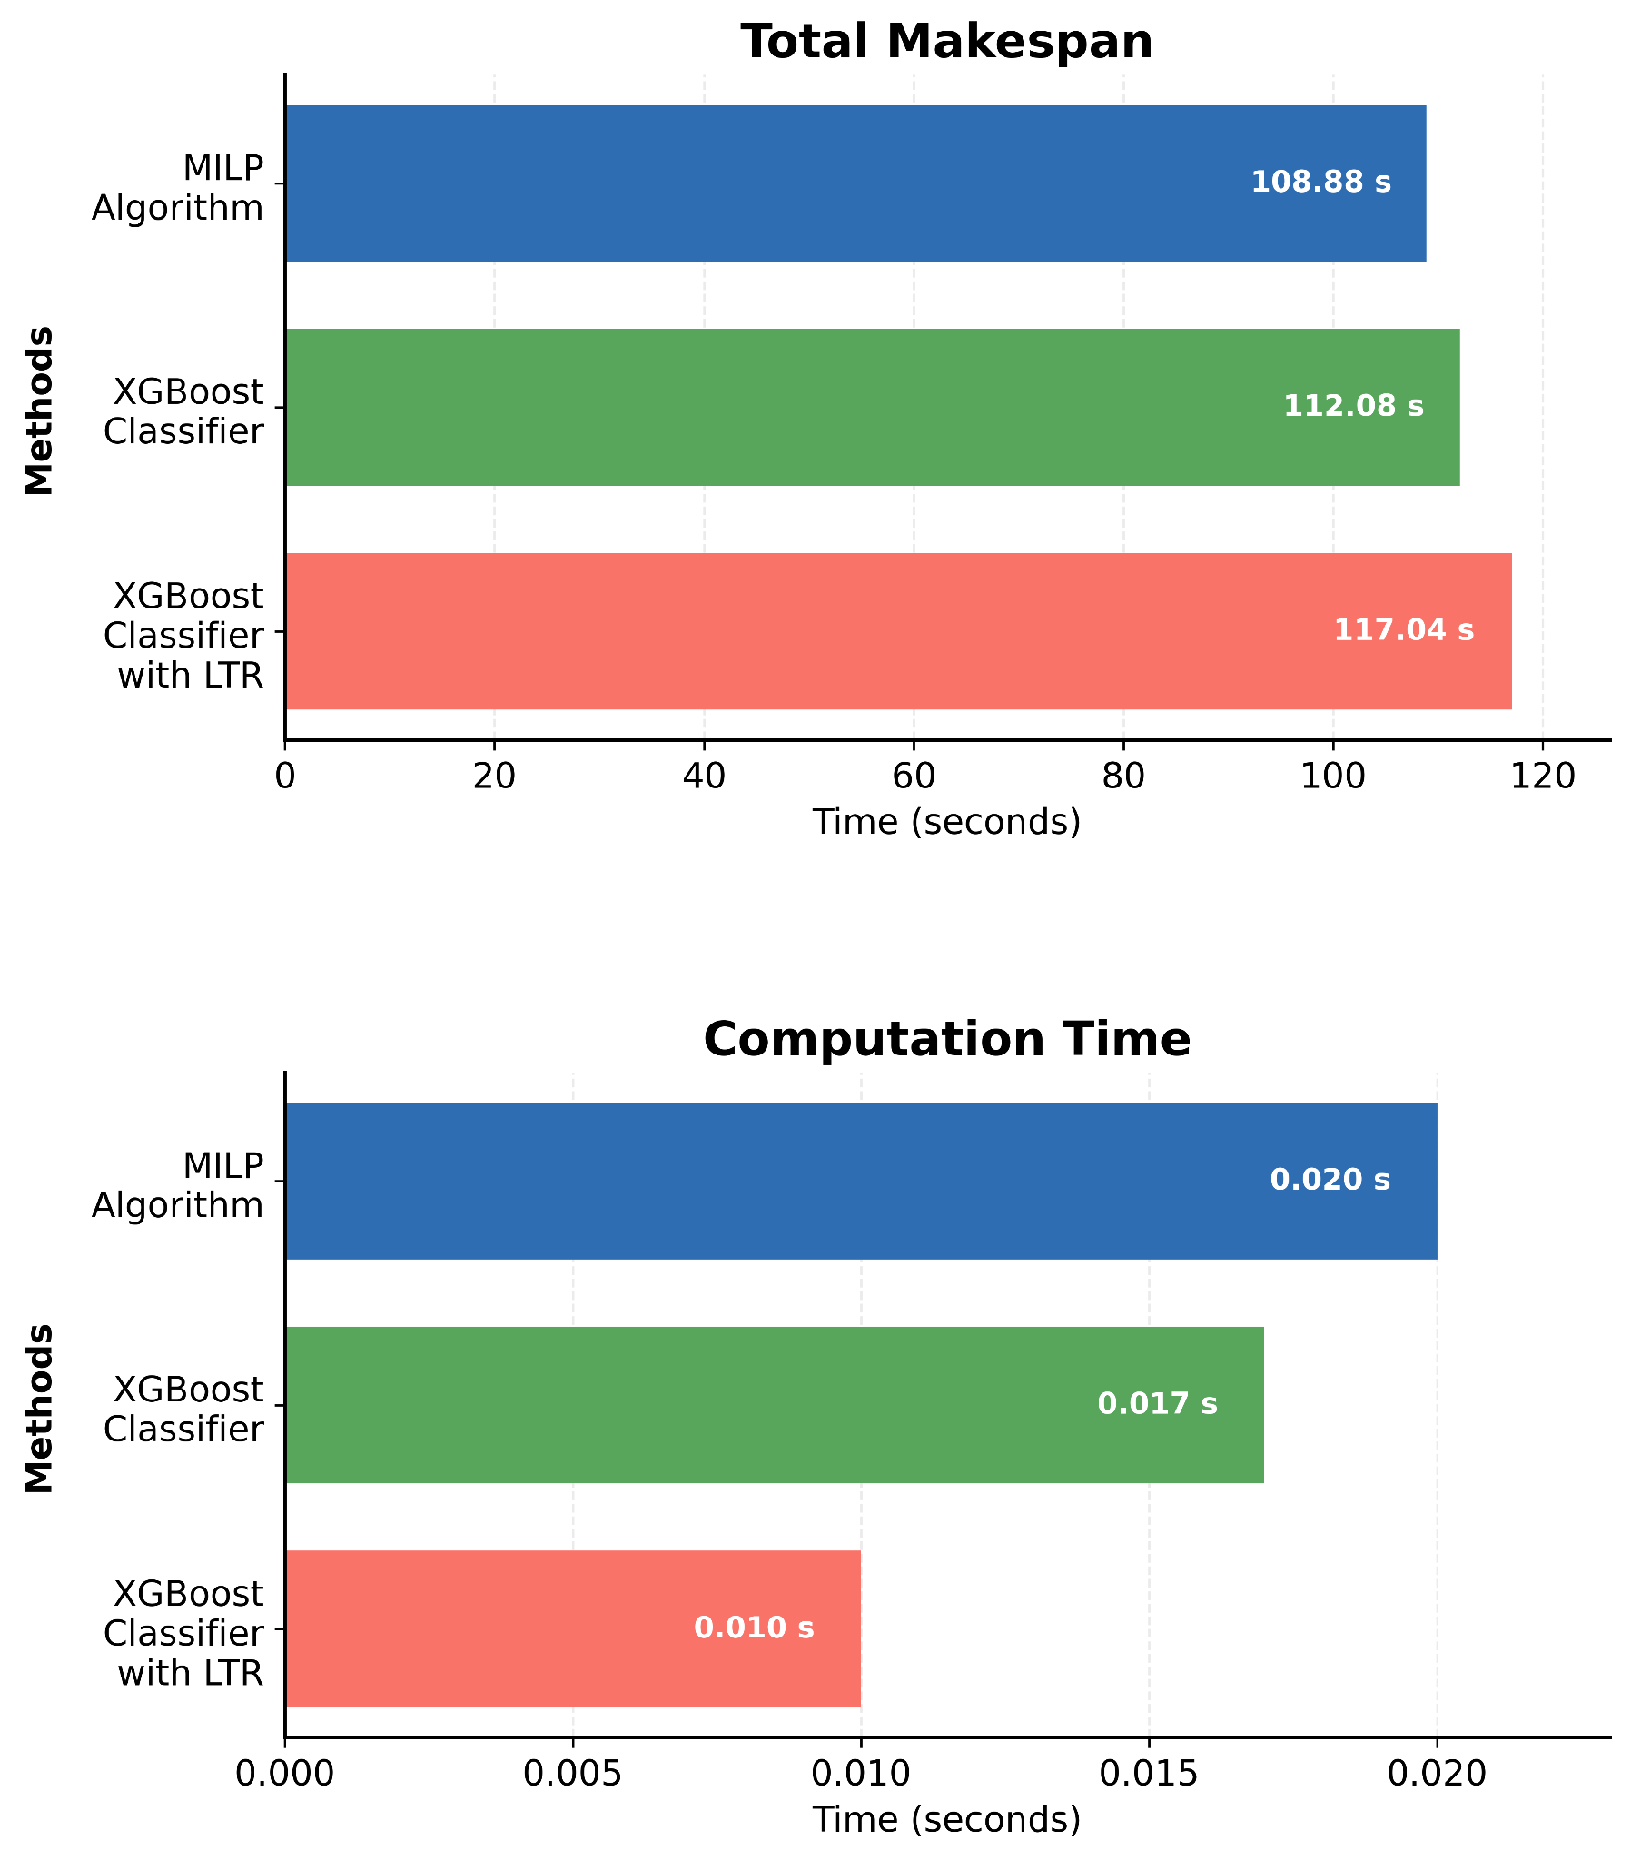
4. Tests and Results
4.2 System Evaluation
Test Scenario
Fixed 10 Tasks
Same Pattern of Task Arrival
Makespan Gap:
Ranker
First Come First Serve
2.86%
6.94%
Computation Time Reduction:
Ranker
First Come First Serve
15%
50%
Figure 4.1: Comparison plots for fixed 10 tasks

Slide 26
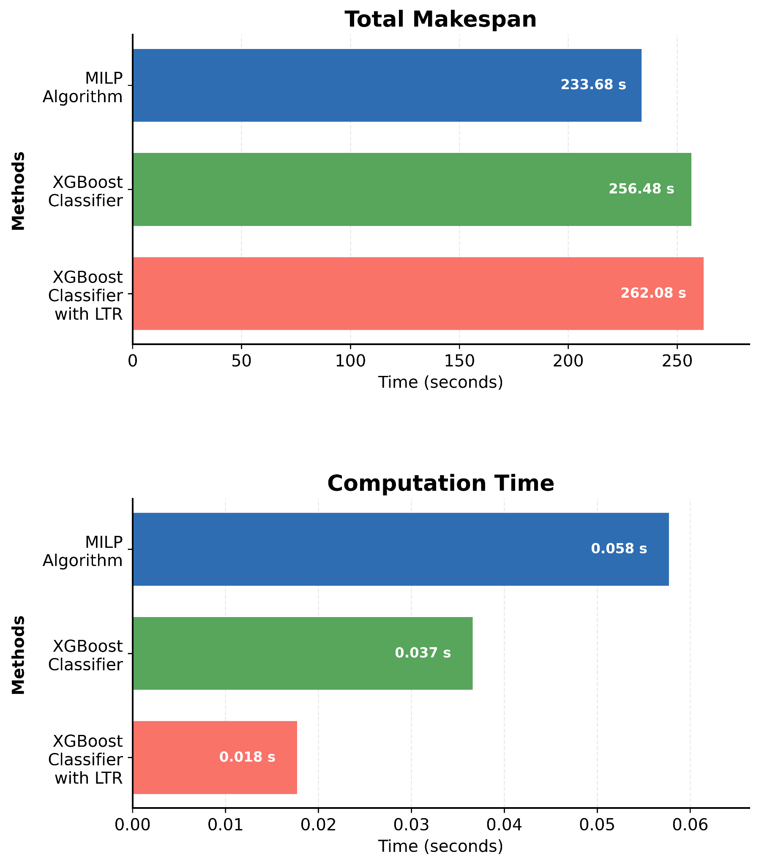
4. Tests and Results
4.2 System Evaluation (Cont’d)
Test Scenario
Fixed 20 Tasks
Same Pattern of Task Arrival
Makespan Gap:
Ranker
First Come First Serve
8.88%
10.83%
Computation Time Reduction:
Ranker
First Come First Serve
36.56%
68.96%
Figure 4.2: Comparison plots for fixed 20 tasks

Slide 27
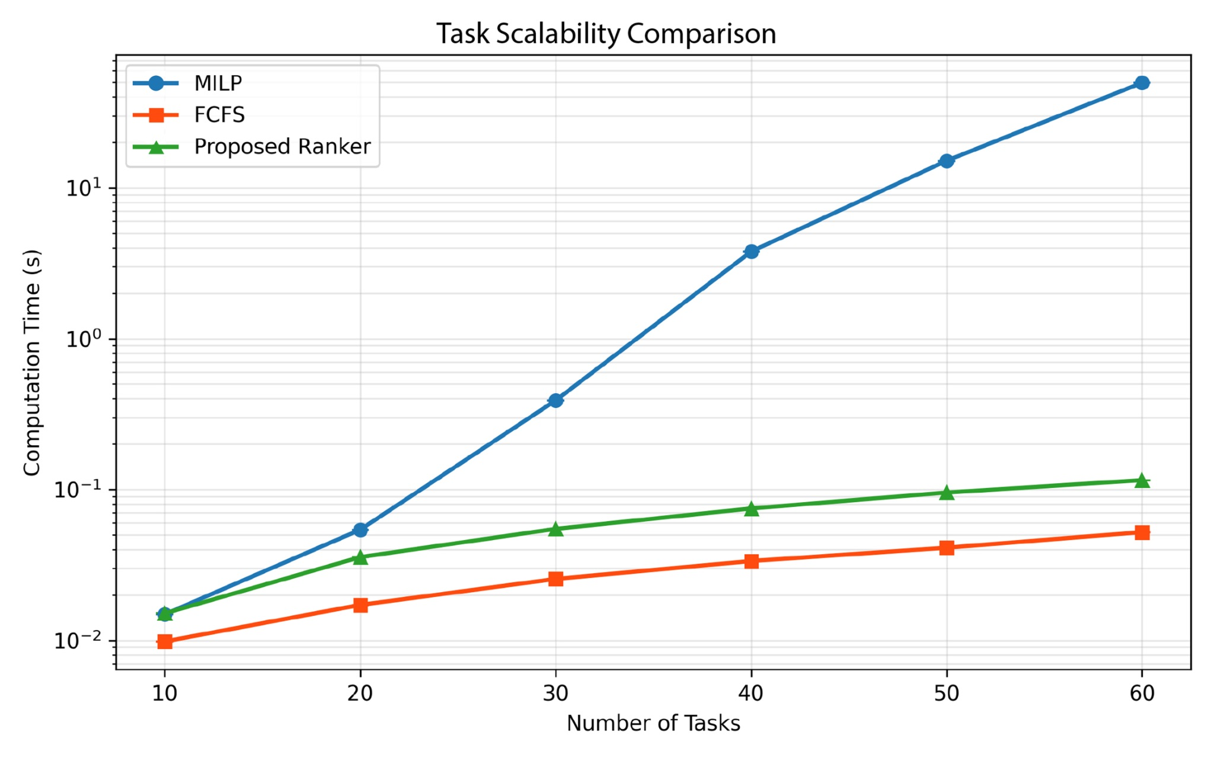
4. Tests and Results
4.3 Task Scalability Comparison
Figure 4.3: Task Scalability Comparison

Slide 28
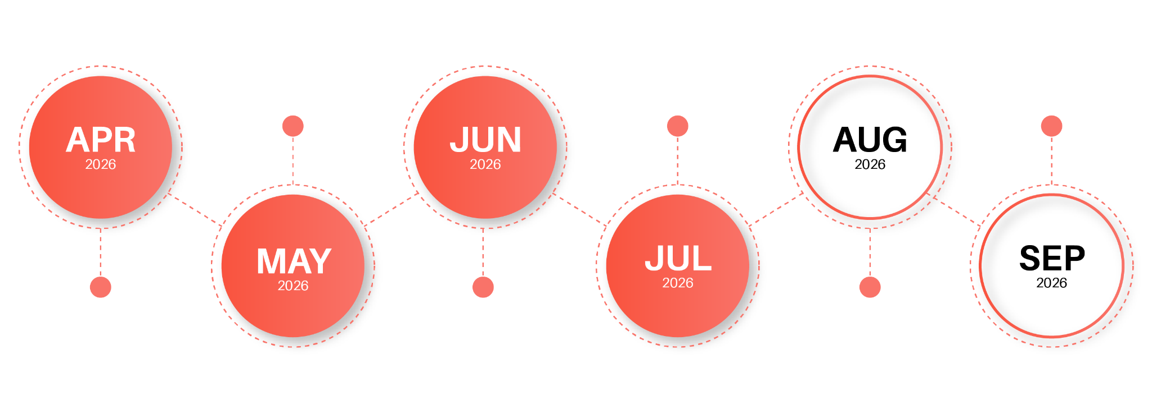
5. Research Timeline
Simulation & MILP Setup
Central Server Architecture
Documentation & Defense
Planning & Research
XGBoost Model
Training
Full System
Testing & Evaluation

Slide 29
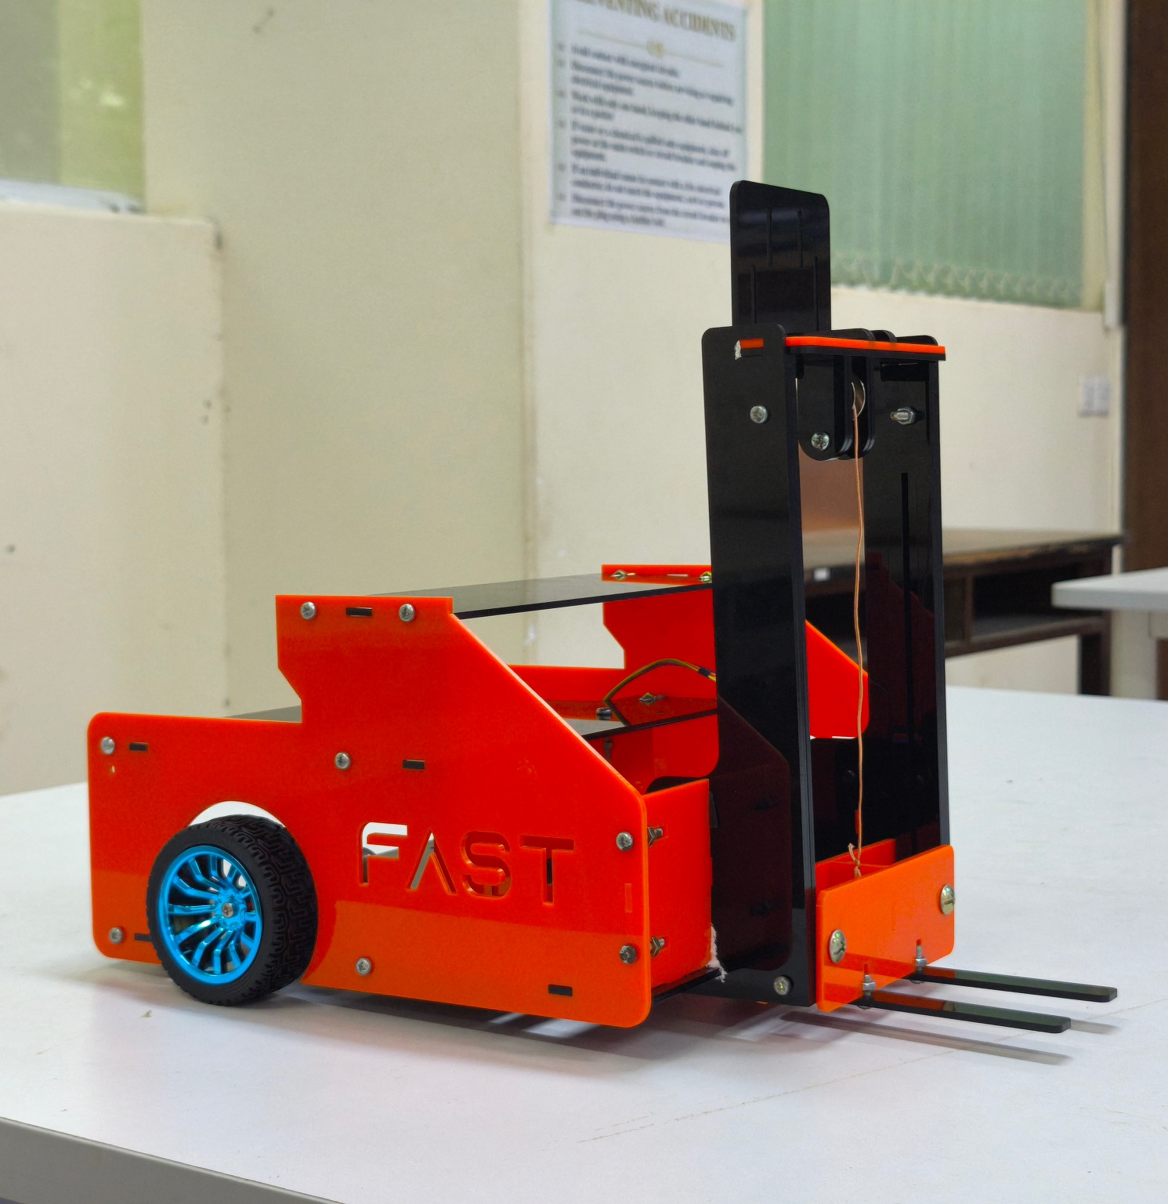
6. Future Work
Integrate the classifier & Learning-to-Rank scheduler into the Warehouse Management System.
Replace the simulation with real robots.
Evaluate the framework on physical warehouse robots.
Figure 6.1: Warehouse Robot Design

Slide 30
7. Conclusion
7. Conclusion
XGBoost classifier successfully learned optimal robot assignment.
Learning-to-Rank model developed for dynamic queue reordering.
Overall scheduling performance significantly improved over First Come First Serve model.
Future Integration into the warehouse management system and system evaluation with physical robots.

Slide 31
8. References
[1]
[2]
[3]
[4]
[5]
[6]
Pal A, Chauhan A, Baranwal M, Ojha A. , "Optimizing Multi-Robot Task Allocation in Dynamic Environments via Heuristic-Guided Reinforcement Learning", ECAI, 2024.
Park B, Kang C, Choi J. , "Cooperative Multi-Robot Task Allocation with Reinforcement Learning", Applied Sciences, 2022.
Putatunda S, Rama K. , "A Modified Bayesian Optimization based Hyper-Parameter Tuning Approach for Extreme Gradient Boosting", 2019.
Sharma A., "Listwise Learning to Rank with Deep Q-Networks", 2020.
Atay N., Bayazit B., "Mixed-Integer Linear Programming Solution to Multi-Robot Task Allocation Problem", Washington University in St. Louis, 2006
Athira K. A., Udayan J. D., Subramaniam U., "A Systematic Literature Review on Multi-Robot Task Allocation", ACM Computing Surveys, vol. 57, no. 3, 2024.

Slide 32
“Thank You”
for Your Time and Attention!

